Slide 1
Intervene
Bystander Intervention Workshop Laura Santacrose, MPH
Assistant Director
Skorton Center for Health Initiatives
Cornell Health
Notes:
Intro: 2 mins
Hello/Welcome…my name is …. Thank you for being here today/tonight for this bystander intervention workshop entitled “Intervene”.
As students, there are times when you may see something that doesn’t seem quite right. It might be obvious or it might be subtle. Sometimes intervening is simple. Sometimes it’s not. You may feel a little awkward, but it doesn’t mean it’s not working. Your actions still have an impact, whether in the moment or down the road.
During our time together, we are going to explore what it might mean to intervene when someone is in a difficult situation or may even be in danger.
To begin, we are going to watch a set of 7 distinct scenarios in one film. As you watch, please pay attention to how the characters interact with each other as well as how the scenarios are similar to and different from one other.
These scenarios are based on real experiences of undergraduate, graduate (and professional) students. Some of these situations occur with greater frequency than others. Like many on our campus, you may have witnessed, directly experienced, or intervened in one or more of these types of situations.
Any of these scenarios may hit close to home for some of us, so we will want to be mindful of this and respectful in the conversation we will have following the film.
During our discussion, please remember that each person’s perspective is welcomed. We are here to learn from each other, so I invite you to share from your own point of view and to listen for understanding to others. With that, let’s get right into the film. This is “Intervene”…
Click on hyperlink to video: “Bystander Intervention Workshop” on slide TURN on CC’s - bottom right corner of video screen

Slide 2
Intervene Scenarios
 | Scenario | Ind./Group
1 | Stranger and friends intervened in a potential sexual assault | Ind. & Group
2 | Friends intervened in a racial bias situation | Group
3 | Roommate intervened in a hazing situation | Ind.
4 | Acquaintance intervened w/ person feeling overwhelmed by academics | Ind.
5 | Classmates intervened in a sexual harassment/gender bias situation | Group
6 | Friend intervened in an intimate partner violence (emotional abuse) situation | Ind.
7 | Friends intervened in an alcohol emergency | Ind. & Group
Notes:
“You just saw a lot, right?” OR “That was a lot to take in.” “Let’s review the actual scenes.”
→Recap the scenarios using the table on the slide.
“Turn to the person next to you and share your initial reaction, thought, feeling, idea, etc..” (1-1 ½ mins)
[Go to the next slide]

Slide 3
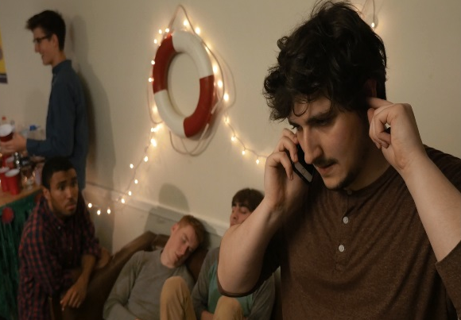
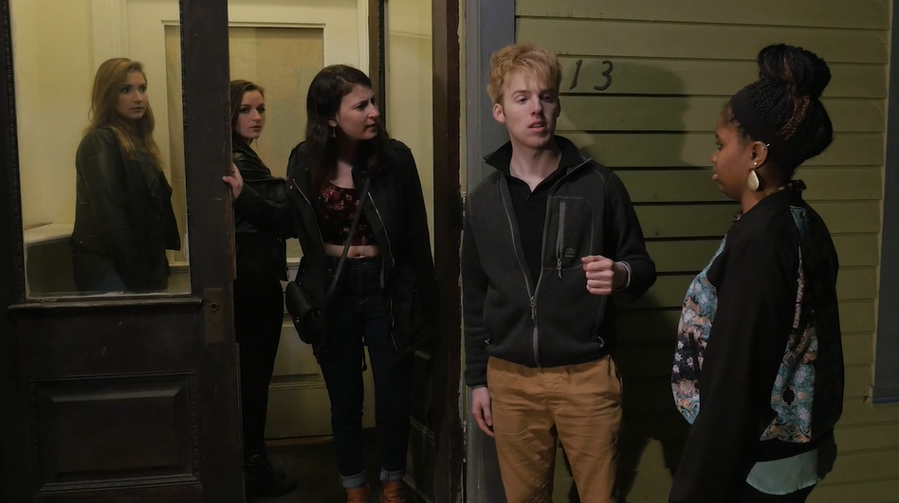
Initial Reactions to the film?
Notes:
Let’s hear a few of your reactions: (2 mins)
Who is willing to share with the whole group?
Are there others who had a similar reaction? Different reactions, comments?
[Option to return to previous slide to allow group to see all seven scenarios while sharing initial reactions]
Typical responses include:
→ better than I thought it was going to be
→ pretty realistic, could relate to many of the scenes
→ video made it seem too easy to intervene – real life isn’t always that clear
→ surprised that the characters did xyz → afraid of backlash..

Slide 4
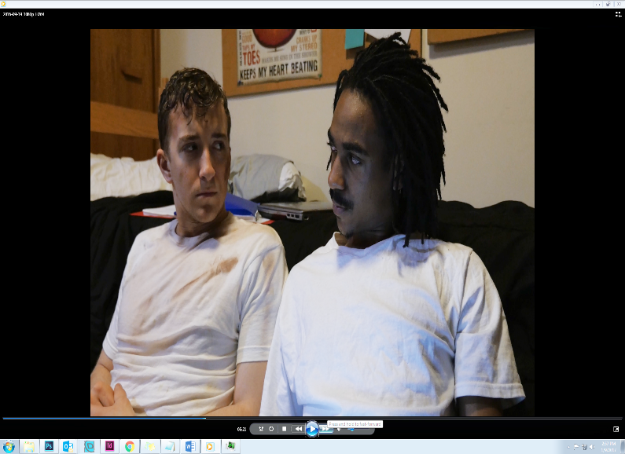
Signs of a Problem
What can make it hard to tell if what you are seeing is a problem?
In any of the scenarios, what did the characters see or hear that concerned them?
Notes:
Let’s talk for a minute about the signs of a problem:
(Read first bullet on slide) “What can make it hard to tell…” After a few responses be sure to cover the following examples:
Role of relationships (friends, strangers, upper-class members, leaders, etc.)
Sense of responsibility
Being intoxicated / drunk yourself
Not sure if it’s serious enough to intervene
If the person in need of help seems to be wanting to do something or says it’s okay but it’s clearly not okay.
Not sure if they want to get into someone else’s business/crossing the boundary
If no one else seems to think it’s a problem – normative to see xyz and people not do something
Not having enough information
Don’t want to make a scene
Fear of being uncool
Go to the second bullet on slide (click for animation) and read: what did the characters notice that concerned them?… After a few responses…
Blackout drunk (SA) passed out from alcohol (Alcohol)
Change in behavior (hazing, IPV)
Distressed – physically disheveled, visibly distressed, crying, shaky voice, etc. (hazing, IPV, SH, MH)
Differential treatment /someone being singled out (Bias, SH)
Loss of autonomy/person in need loss of control (hazing, IPV, SA)

Slide 5
Bystander Emotions
What do you think the bystanders were thinking and/or feeling when they noticed a problem?
Why did the bystanders decide to do something?
Their sense of responsibility to their peers outweighed their fears and worries.
Notes:
When you’re a bystander in concerning situations, you may have lots of thoughts and feelings about what is happening.
Read 1st bullet on slide: What do you think some of those thoughts or feelings might be?
Typical responses include:
Nervous, uncomfortable, felt awkward
Uncertainty – what to do, what to say, uncertain of outcome
Gut feeling that this isn’t right, angry at the injustice
Don’t know what to say or do / say the wrong thing / mental hurdle to jump over
Shock that they just said that or did that
Not sure they can help
Fear of being wrong about the situation
Worried about damaging the relationship
Worried about making it worse
Worried about what other people might think of them
Think someone else will take care of it
Guilt or obligation or duty to help someone out (which can be a motivator – first response)
[Might follow with: “Could you ever see yourself overcoming worry, fear, etc. in a situation to help a friend/ someone?”]
→sometimes it helps to have someone else to intervene with (strength in numbers)
Next question: Why did the bystanders decide to do something?
Typical responses include: -if they say “I can’t talk about it” that’s usually a pretty big sign.
-”I’m fine” is not really a “Yes, I’m doing great” answer.
-Feeling protective of their friends and wanted to be in solidarity and help.
-Felt offended by what was happening themselves (righteous anger)
→ If the group isn’t coming up with anything, ask “To what extent did the characters feel responsible to say or do something?”
Encourage discussion on sense of responsibility with a friend, acquaintance or stranger, as a member of the campus community.
The emotions you identified earlier are things that the bystanders overcame in order to take action.
Feelings of responsibility and risk of not doing something > outweighed the fear /barriers/concerns about intervening.

Slide 6
Role of Relationship
Friend
Roommate or teammate
Best friend
Acquaintance
Stranger
Potential Sexual Assault
Bias (racial or other)
Hazing
Academic Stress
Sexual Harassment
Intimate Partner Violence
Alcohol Emergency
Notes:
In the different scenes we saw different types of relationships among the characters. Let’s spend a minute longer on the Role of Relationship. (Click for first animation)
To what extent would knowing the person in need of help make it more or less likely that you might act?
And what about hierarchy or power differences in the relationship? (Click for second animation)
What if the person in need of help is older than you or has “status” over you, like being the team captain or an officer in your student organization? Does that change how you think about intervening?
What if the person perpetuating the problem is a faculty member?
Is it easier or harder to take action depending on the type of situation? (Click for next animation)

Slide 7
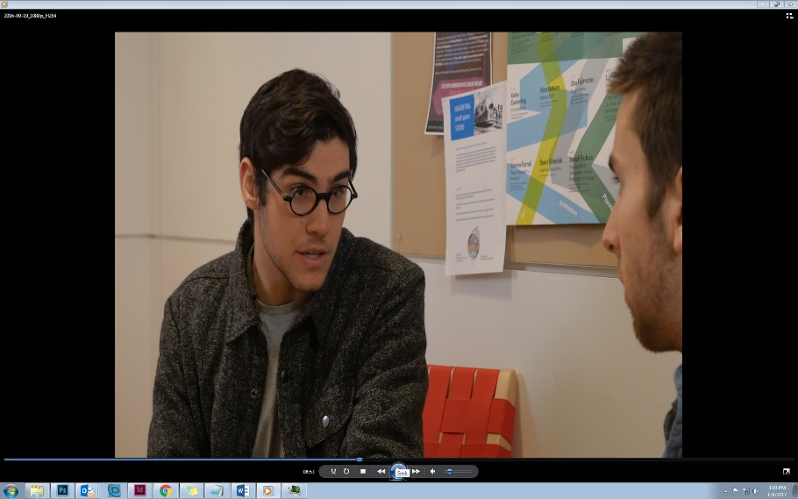
Taking Action
Non-urgent situations
Listen
Express concern
Describe what you observe
Offer support
Connect to resources
Urgent/emergency situations
Don’t assume others will act
Act with others if possible
Be direct or distract
Call for help
?
Notes:
“In the film, we saw the characters take action in many ways (which we’ve been discussing) both in urgent and non-urgent situations.”
Read slide:
Non-urgent situations (Click for animation)
Listen, empathize, and validate (MH, IPV)
Express concern (SA, Hazing, IPV)
Describe what you observe (non-judgmentally) (Hazing, MH)
Offer support (Racial Bias, Gender Bias/ SH, IPV)
Connect to resources (MH, IPV)
Urgent/emergency situations (click for animation)
Don’t assume others will act (All)
Act with others if possible (SA, Gender Bias/SH, Alcohol Emergency)
Be direct or distract (SA)
Call for help (Alcohol Emergency)
Which of the situations would you consider to be an emergency? – Answer = Alcohol emergency.
→ What made that alcohol situation an emergency?
→ (Ask group for signs of alcohol poisoning, and fill in the gaps. Go to next slide)
→[They might say, the potential sexual assault… if so, we might say something like “yes, this could have ended up being an emergency, but at this stage it was at least an urgent situation, and it’s really good the friends acted quickly. There was another scenario, however, that was already at the life or death, emergency stage. Which one was that?”]

Slide 8
Signs of Alcohol Emergency
A- Alert
Unable to rouse person or keep awake
Vomiting while passed out or incoherent
B- Breathing
Breathing slow, irregular pulse
C- Color/ Clammy
Skin color “off” or lips bluish, cold or “clammy” to the touch
D- Doubt
Not sure
Head injury, mixed with other drugs
Notes:
One way to remember the signs of alcohol poisoning: the ABCDs
Read slide.
Any one of these signs indicates the need to call for medical assistance.

Slide 9
What to Do: Alcohol or Other Drug Emergencies
Call for help: medical evaluation
911 Emergency or University Police
Stay with the person until help arrives
Turn the person on their side
Remember the University Good Samaritan Protocol and NYS Law
You and the ill person won’t get in trouble for underage drinking
or use of other drugs
Notes:
Once you recognize the signs of an alcohol or other drug emergency, this is what needs to happen: read the slide

Slide 10
How High Risk Behaviors Get Camouflaged
It seems that no one else finds these behaviors troubling; they seem to be a norm.
Sometimes we see something problematic and choose not to act when we probably should do something.
This doesn’t make us “bad;” it makes us human.
We can begin to remove the camouflage by directly addressing these problematic and high-risk behaviors when they occur. This is how we can create a new norm.
Notes:
Let’s talk about how these high risk behaviors are camouflaged and not seen as problematic. We saw this in the alcohol emergency scenario where people just walked over the person passed out on the floor for awhile, acting as if nothing was wrong or out of the ordinary rather than immediately calling for medical attention for an individual who was passed out from alcohol poisoning.” “Have you ever seen this (alcohol emergency) at a party?”
Then read the slide content.
Follow with: “How do other problematic behaviors get camouflaged here on our campus?” (Get them to share examples like: Offensive comments or jokes– racial, sexist, homophobic, anti-Semitic; Drunk hooking-up; “Minor” hazing. Language contributes to the camouflage too – problematic language in music, people saying “that’s so retarded” and “I raped that test” “I’m so stressed, just kill me”. Problematic party themes : CEOs and Hoes, racist themes, etc. Normalize blacking out – goal for the night rather than asking is everything okay? High value on being in a relationship and therefore disregard unhealthy signs of a relationship. Can you think of others?)

Slide 11
What Can You Do?
You can intervene in any of the ways we have discussed!
Host an Intervene training for another student organization you’re a member of.
Share the video with your friends and continue the conversation.
Know, utilize, and share the campus resources available to you.
Cornell University 2019
Notes:
Share opportunities on campus about how to be an ally in these types of situations.

Slide 12
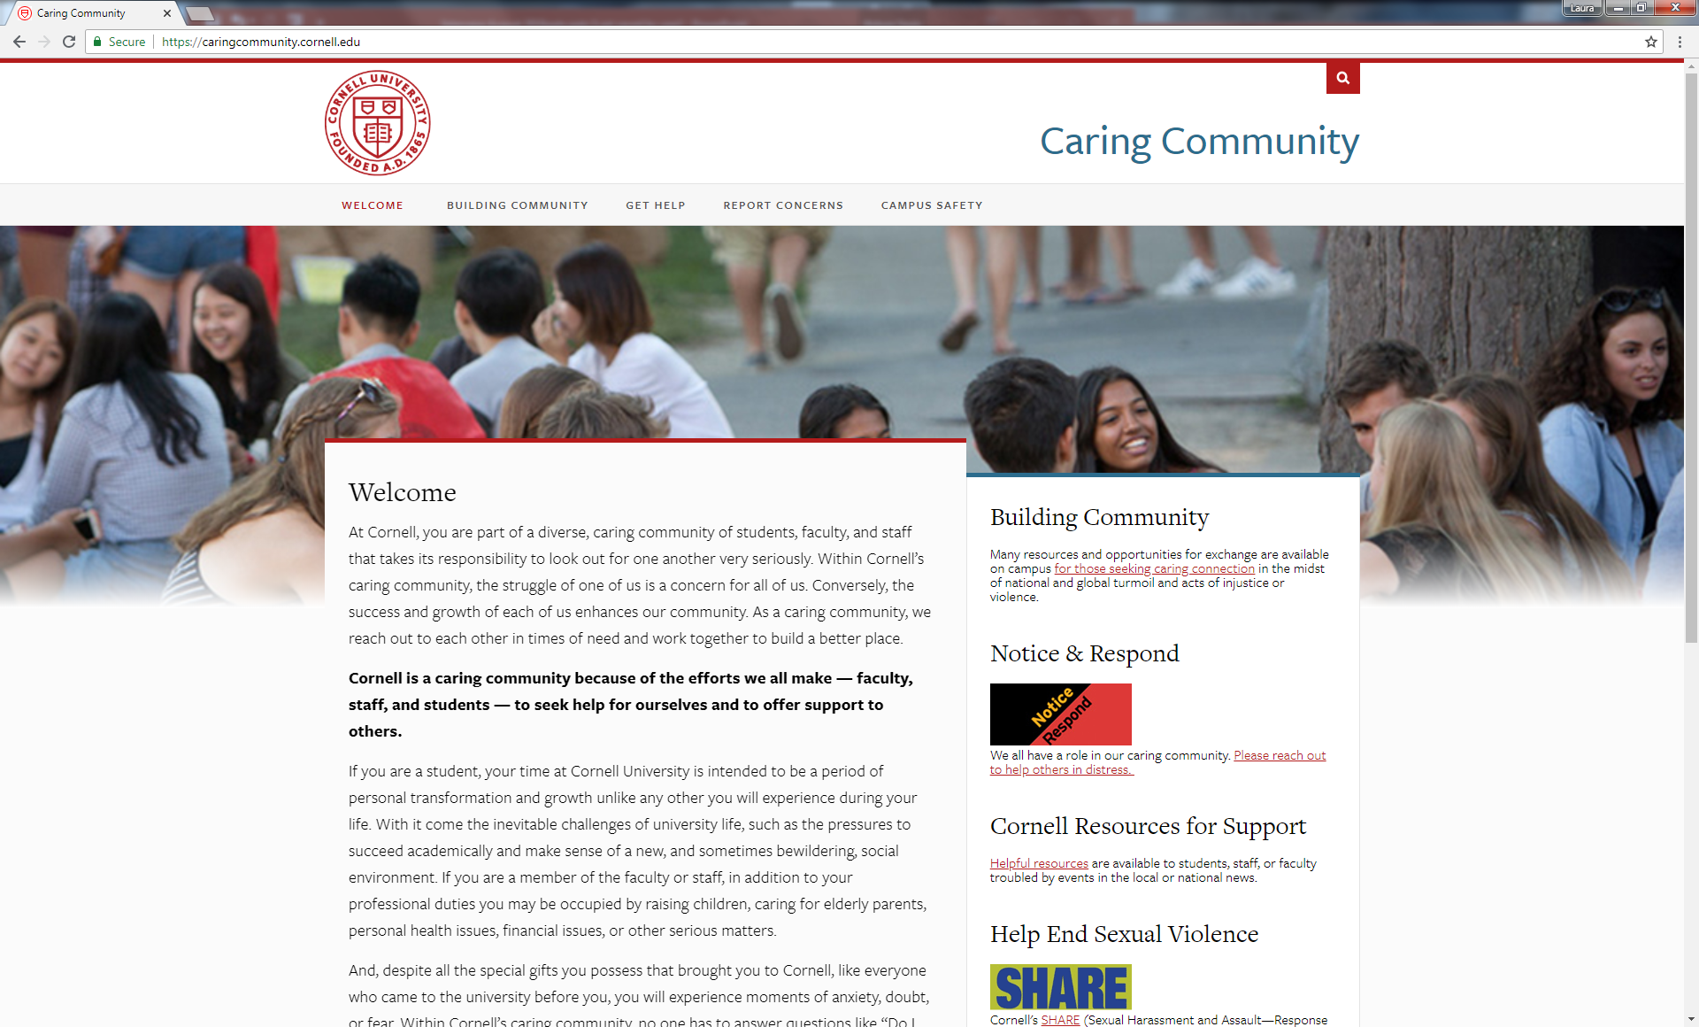
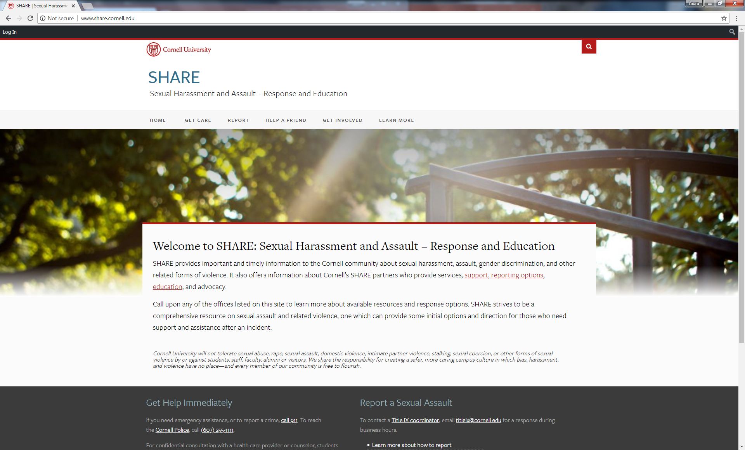
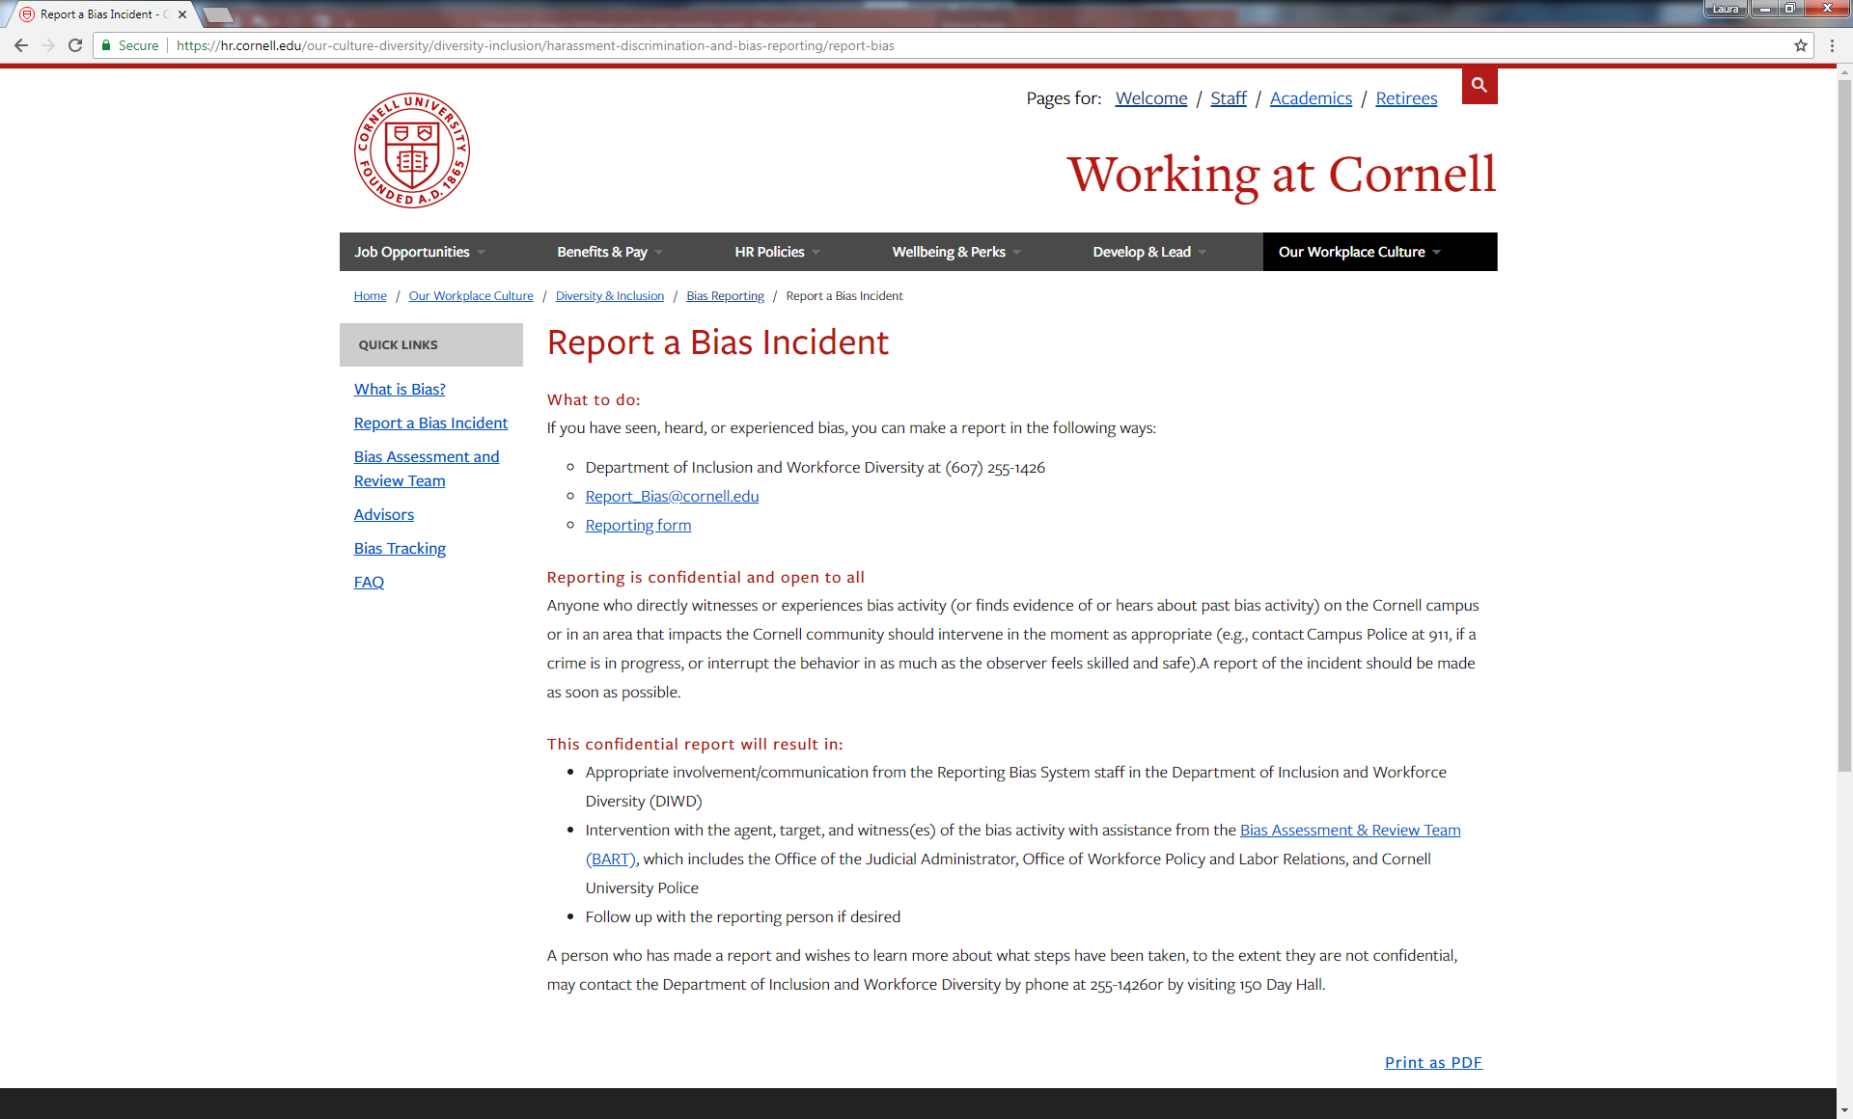
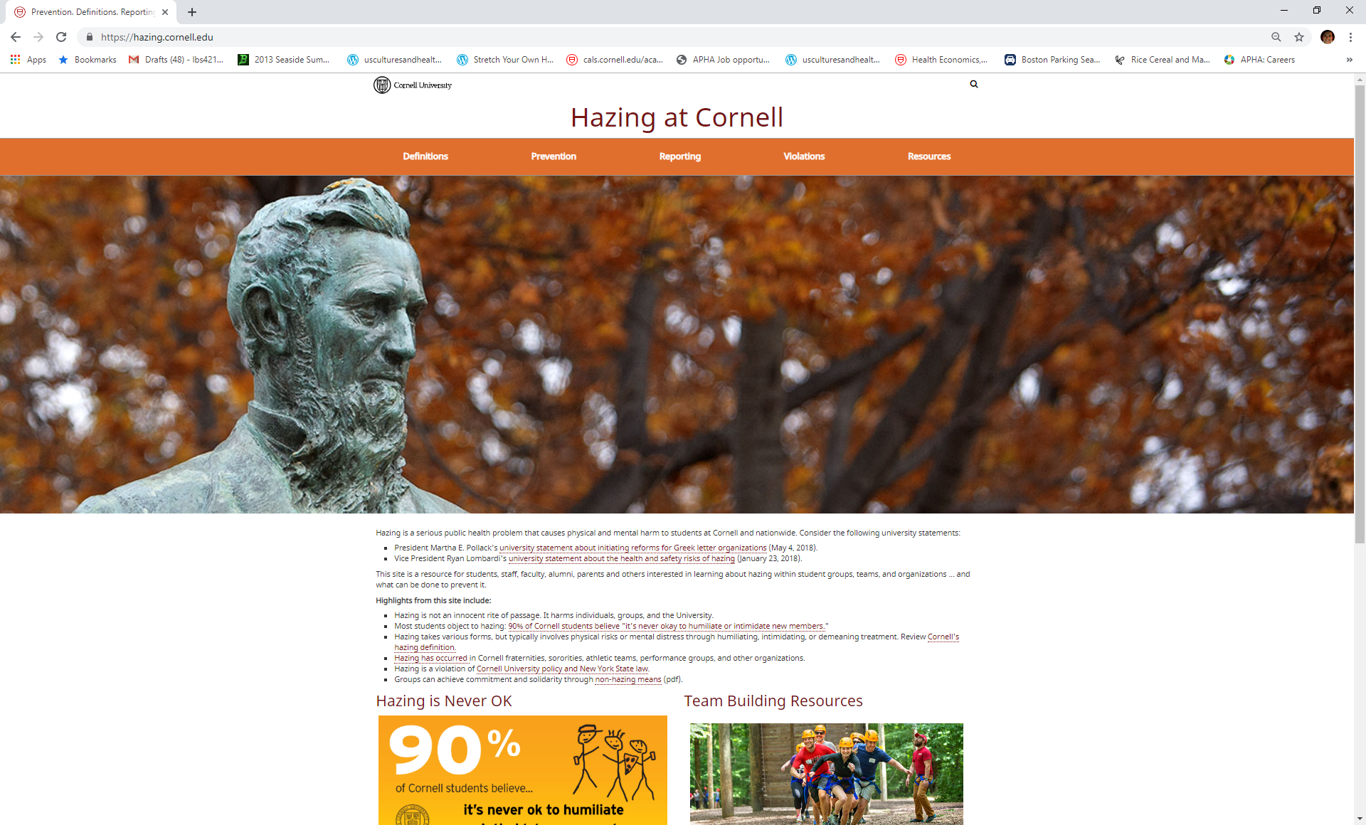
Reporting Concerns & Getting Help
Notes:
[Adapt campus resources to your own institution].
Options for Confidential and/or anonymous reporting:
Explain the various sites on the slide.
Top left=caring community website where these three online reporting forms can be found;
Top right= sexual misconduct reporting (sexual harassment, sexual assault, intimate partner violence)
Bottom left = bias reporting
Bottom right = hazing reporting

Slide 13
Cost of Inaction
What might have happened if none of the characters had intervened?
What could have been the impact on the person in need?
What could have been the impact on the bystanders? How might they have felt?
Notes:
As we wrap up, we’d like to think about what could have happened if no one intervened when they saw problematic behaviors.
What could have been the impact on the person in need? & What could have been the impact on the bystanders if they chose not to act?
Typical responses for what could have happened to the person in need:
Sexual assault
Continued to be hazed, sexually harassed, experience bias related incidents
Continued to be in an unhealthy and abusive relationship (IPV)
Feeling alone and overwhelmed and mental health could continue to decline (MH and Bias & Hazing)
Someone could have died (Alcohol)
Typical responses for what the bystander could have felt if they didn’t help:
Guilt
Worried about what could have happened
Anxious
May avoid the person
Friend could be upset at bystander for NOT doing anything “where were you?”
Could lose a friend

Slide 14
Remember
Sometimes you need to act quickly
Sometimes you can choose when to act
Sometimes you are the only one who can act
Sometimes you can act with others
Doing something may involve taking a risk
Doing nothing may be a greater risk
We are all part of a community.
You can make a difference by caring and intervening.
Notes:
Remember being a pro-social bystander means…
Click for animations (4x) and read slide.
Sometimes you need to act quickly (emergency)
Sometimes you can choose when to act (non-urgent situations – can strategize/choose the right person)

Slide 15
Thank you!
Laura Santacrose, ’11, MPH
lbs65@cornell.edu
Assistant Director
Skorton Center for Health Initiatives
Cornell Health
Notes:
Intervene (video and workshop) were developed by the Skorton Center for Health Initiatives at Cornell University @ 2016. The information contained in the materials is based on the developers’ best efforts to interpret a body of research and literature, and to translate this into practical considerations. The materials are informational and educational in nature, and are intended to be used as developed and prepared by the Skorton Center for Health Initiatives. The video content is not to be modified, altered or revised in any way. The workshop content is not to be modified, altered, or revised in any way, except for tailoring to your own institutional practices, policies and resources. The Skorton Center makes no representation or warranty express or implied regarding any particular outcome from the use of the materials. Use in part or whole is permitted with attribution to developers.

Slide 16
Intervene (video and workshop) were developed by the Skorton Center for Health Initiatives at Cornell University @ 2016. The information contained in the materials is based on the developers’ best efforts to interpret a body of research and literature, and to translate this into practical considerations. The materials are informational and educational in nature, and are intended to be used as developed and prepared by the Skorton Center for Health Initiatives. The video content is not to be modified, altered or revised in any way. The workshop content is not to be modified, altered, or revised in any way, except for tailoring to your own institutional practices, policies and resources. The Skorton Center makes no representation or warranty express or implied regarding any particular outcome from the use of the materials. Use in part or whole is permitted with attribution to developers.
Notes:
Facilitators: Please read the disclaimer on the slide above prior to facilitating this program.

